Slide 1
Introduction to CLI
HILT 2019

Slide 2
Right now we will cover: … and will gesture toward:
What is the “command line interface”?
How do I use it?
WHY would I use it?

Slide 3

Programming Rules
Expect confusion.
Embrace it!
Ask questions.
Look online!

Slide 5
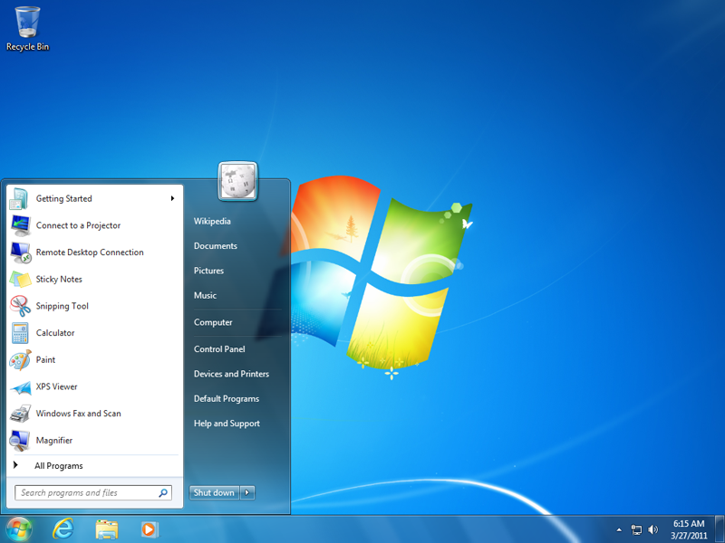

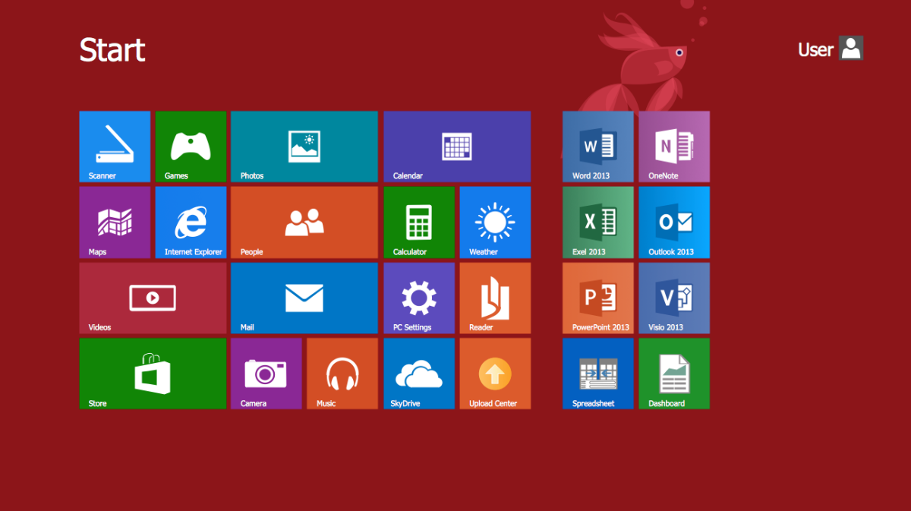
GUI (Graphical User Interface)

Slide 6
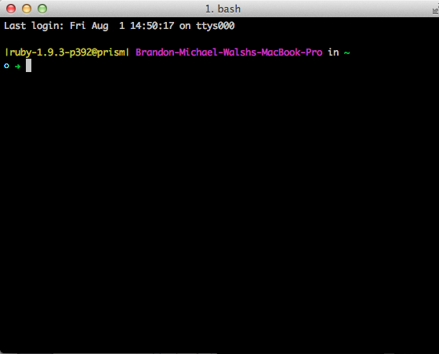
CLI (Command Line Interface)

Slide 7
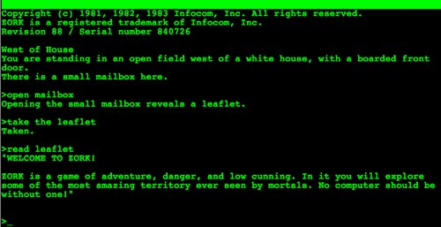
From Zork, 1981

Slide 8
Commands We’ll Learn
Command Structure
cd – change directory
ls – list directory contents
pwd – print working directory
touch – create new file
rm – remove file (careful!)
mkdir – make directory
cp – copy file
mv – move file
man – help page
$ command parameters
$ mkdir new_project
$ touch index.html
command = what to do
parameters = how or to what

Slide 9
You are a programmer!

Slide 10
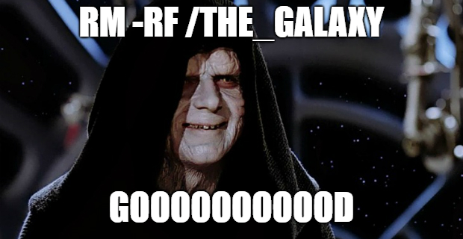
With great power….

Slide 11
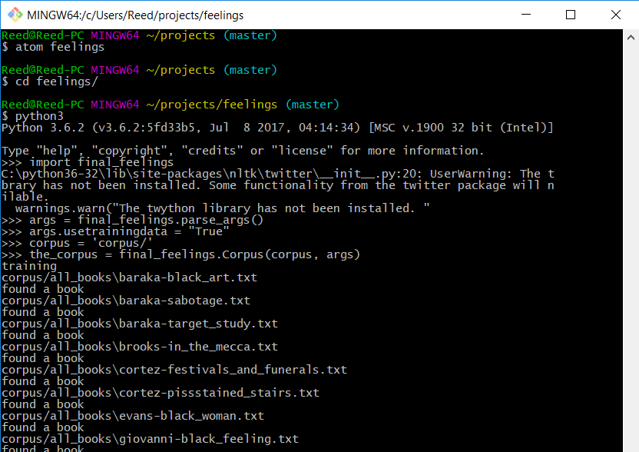
So why would I use the CLI in a DH project?

Slide 12
Getting Help for the NEXT LEVEL
Learn Code the Hard way
http://cli.learncodethehardway.org/
Codecademy
https://www.codecademy.com/learn/learn-the-command-line
CLI Quiz
https://github.com/bmw9t/command_line_quiz/

Slide 13
Introduction to Git
HILT 2019

Slide 14
Version Controlling
Save TONS of different versions of project over time.
Can recover ANY of those iterations.
Nothing is ever lost.
The date, time, and extent of every change is logged (so is the person who made the changes).

Slide 15
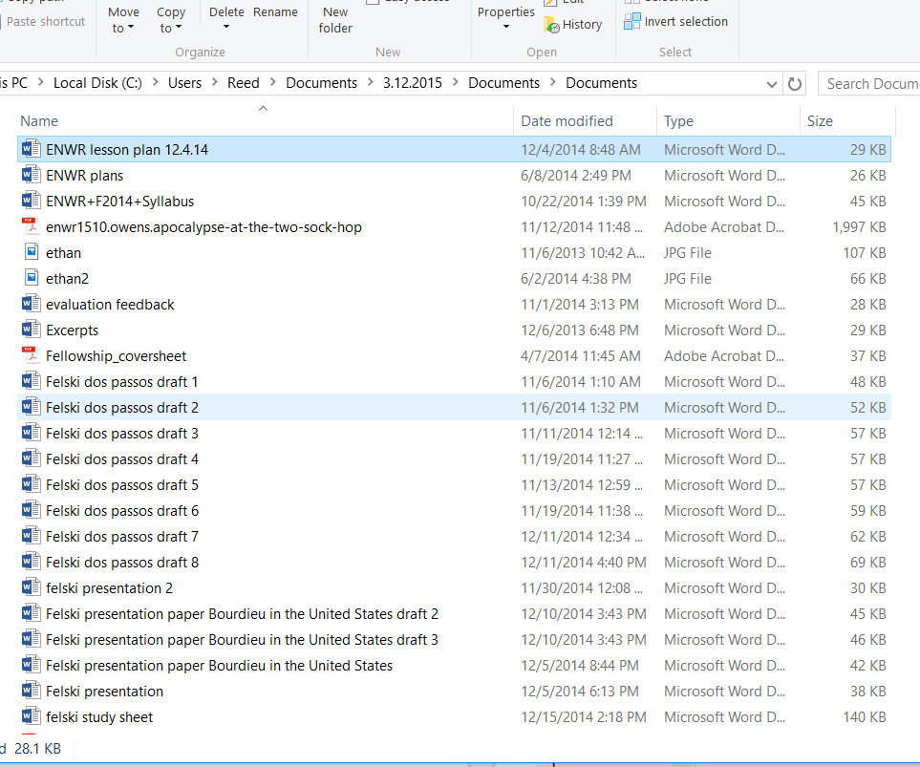
:(

Slide 16
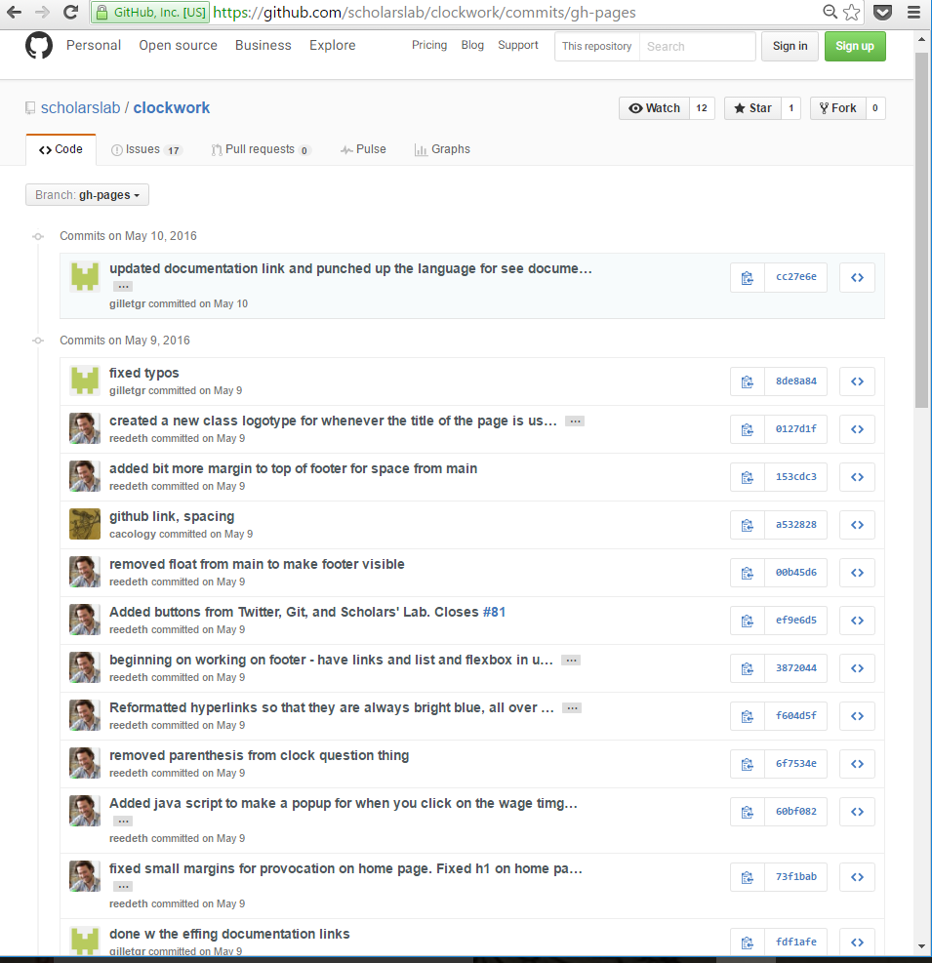
:)

Slide 17
Git
Distributed Version Control System.
Each clone gets the entire project history.
Code exists, in full, everywhere.
Allows easy collaboration via GitHub.

Slide 18
Workflow with Commands
1. Modify a file (in a text editor).
2. Add that file to the staging area.
$ git add file_name
3. Commit it to the repository (with a message).
$ git commit –m “Increased the font size of the title”
4. Start process over.
http://rogerdudler.github.io/git-guide/files/git_cheat_sheet.pdf

Slide 19
Commands We’ll Learn
git init
git status
git add
git commit –m
git push
git branch
git checkout
git merge
git diff
git log

Slide 20
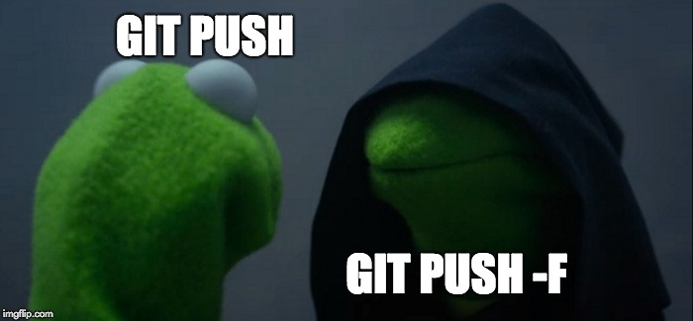

Slide 21
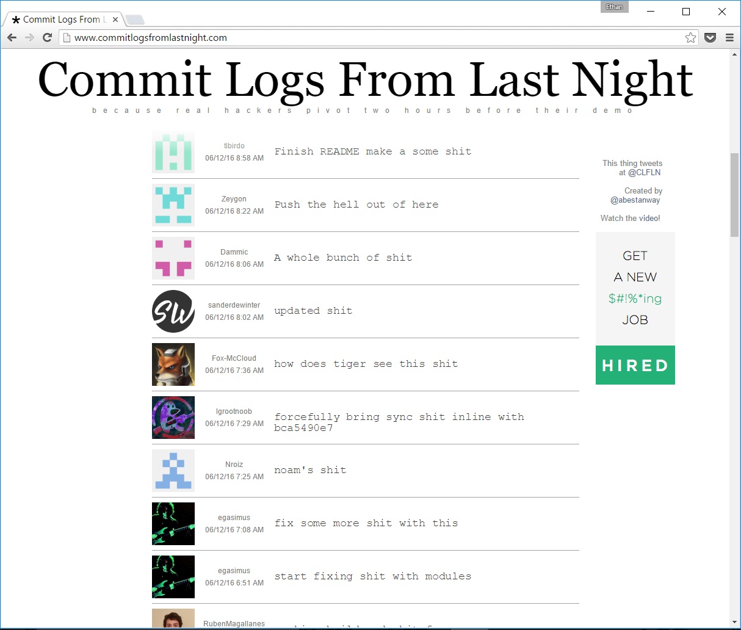
The Importance of Informative Commit Messages!

Slide 22
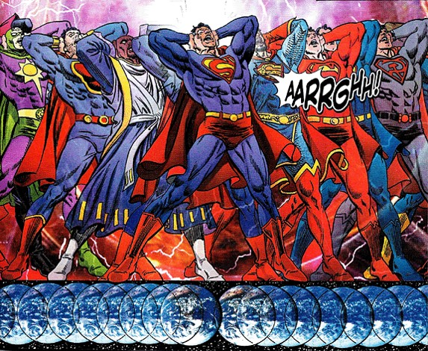
The Parallel Universes of Git Branches & Merges ---as easy as comic book storylines!!

Slide 23
Getting Help for the NEXT LEVEL
Git tutorials and documentation
https://www.atlassian.com/git/tutorials/
https://www.codecademy.com/learn/learn-git
https://git-scm.com/doc
Git for ages 4 and up
https://youtu.be/1ffBJ4sVUb4
GitHub
https://github.com/
http://rogerdudler.github.io/git-guide/
https://guides.github.com/

